Slide 1
INDIAN Credit & Debit Card Payments Data Analysis
Created By- Sanjay Kamble

Slide 2
Objective:
To get the useful insights to the credit card and debt card payments statistics in INDIA. The data analysis has been performed with Tableau tool.
Tableau:
Tableau is one of the powerful and fastest growing data visualization tool used in the Business Intelligence Industry. It helps in creating interactive visualizations in the form of dashboards and worksheets.
Synopsis:
The Reserve Bank of INDIA (RBI), releases bank wise data every monthly. This data contains useful statistics about ATMs, Point of Sales (PoS), Credit Card, Debit Card , number of transactions etc.
The dataset is very useful to get insights on debit card and credit card payments trends.
Data:
Link to dataset
The dataset is available on monthly basis on RBI’s site. Hence the gathering of data and integrate can be a challenging task. However the it has been documented i.e web scrapping, data cleaning etc. here
***Columns in dataset ****
Number of ATM deployed on site by the bank.
Number of ATM deployed off site by the bank.
Number of POS deployed online by the bank
Number of POS deployed offline by the bank
Total number of credit cards issued outstanding (after adjusting the number of cards withdrawan/cancelled).
Total number of financial transactions done by the credit card issued by the bank at ATMs
Total number of financial transactions done by the credit card issued by the bank at POS terminals
Total value of financial transactions done by the credit card issued by the bank at ATMs
Total value of financial transactions done by the credit card issued by the bank at POS terminals.
Total number of debit cards issued outstanding (after adjusting the number of cards withdrawan/cancelled).
Total number of financial transactions done by the debit card issued by the bank at ATMs
Total number of financial transactions done by the debit card issued by the bank at POS terminals
Total value of financial transactions done by the debit card issued by the bank at ATMs
Total value of financial transactions done by the debit card issued by the bank at POS terminals.

Slide 3
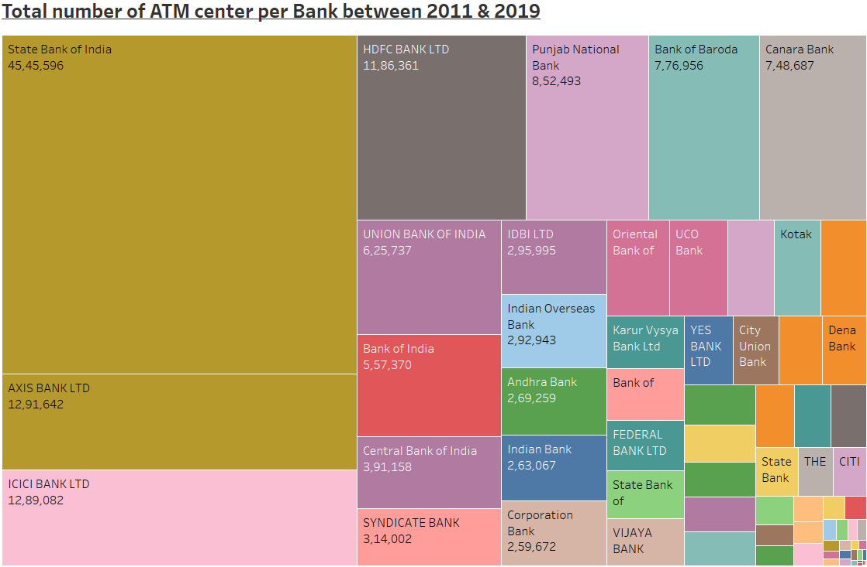
The visualization depicts the ATM numbers for the BANKS between 2011 and 2019.
We can see State bank of India (SBI) is having maximum number of ATM
AXIS Bank. ICICI Banks and HDFC Banks are next with maximum numbers of ATMs.
Out of top 4 banks, only one is government bank, rest are private banks.
Although SBI alone have more ATM than the next few banks from top lists.
Dashboard Link
Note: you can see the bank name with the number of ATM by just a mouse hover the region.

Slide 4
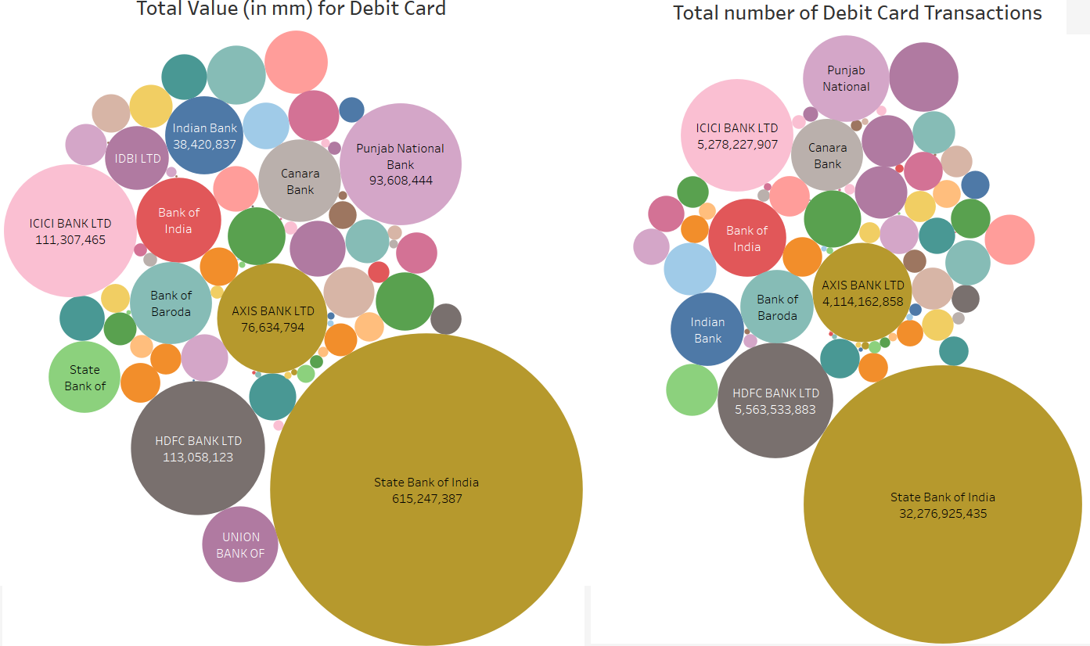
In the visualization, the left bubbles shows the total value of transactions done for the debit card. The values are in million from 2011 to 2019.
The right bubbles shows the total number of transactions done for the debit card.
We can see State Bank of India dominates the numbers.
SBI if follow by HDFC, ICICI PNB & AXIS banks in terms of value.
In terms of numbers of transactions, we have SBI, HDFC, ICICI, AXIS and PNB banks
Although Axis bank debit card was swiped more than PNB but transactions value is more for PBN.
The swipe data includes usage at ATM as well as PoS.
Dashboard Link
Note: hover over on the bubble to see the details.

Slide 5
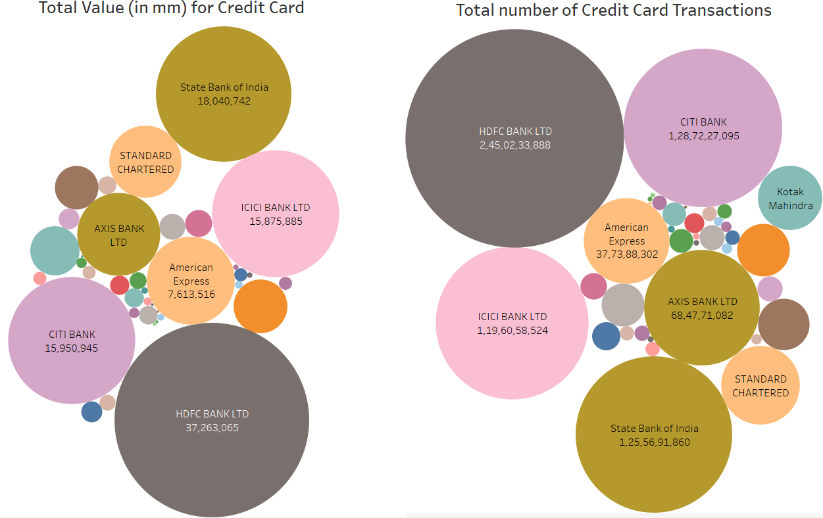
In this visualization, the left bubble shows the total value of transactions done for the credit card. The values are in million from 2011 to 2019.
The right bubble shows the total number of transactions done for the credit card.
We can see domination of HDFC.
HDFC is followed by SBI, CITI and ICICI for the value of transactions.
In terms of numbers of transactions, we have HDFC followed by SBI,CITI,ICICI and AXIS banks.
Although SBI manage to hold 2nd spot, credit card business is primarily, dominated by private banks compare to Governments.
We see new entrance like American Express and Standard Charters which are totally absent in debit card business.
The swipe data includes usage at ATM as well as PoS.
Dashboard Link
Note: hover over on the bubble to see the details.

Slide 6
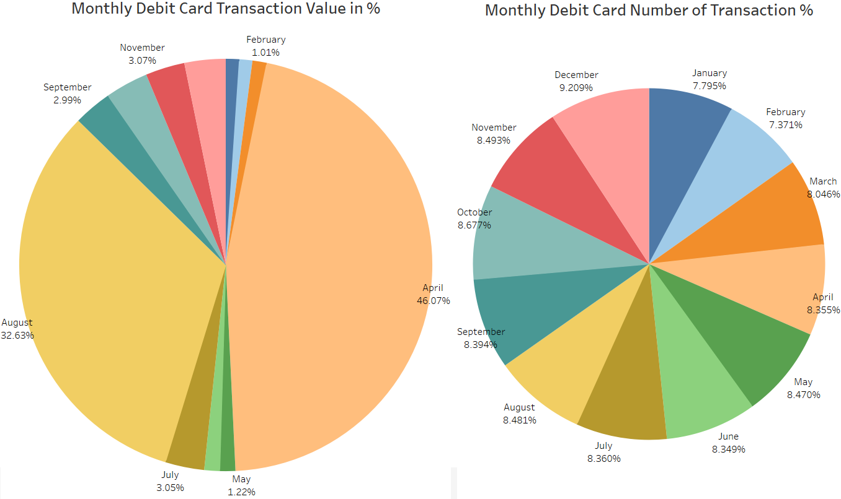
In this visualization, the left pie chart shows the transaction value on monthly basis.
The right pie chart shows the number of transaction done on monthly basis.
We can see that in terms of value, highest amounts were spent in month of April (~46%) and August (~33%).
This makes sense as in India main holiday & wedding season starts in April.
The start of festive season, seems to be reason behind the numbers for August.
Also, if we see at the number of transactions chart, it is almost spread equally throughout the year.
Event the number of transaction were nearby though out the year, the amount spend in April & August are big amounts.
The swipe data includes usage at ATM as well as PoS.
Dashboard Link
Note: hover over on the bubble to see the details.

Slide 7
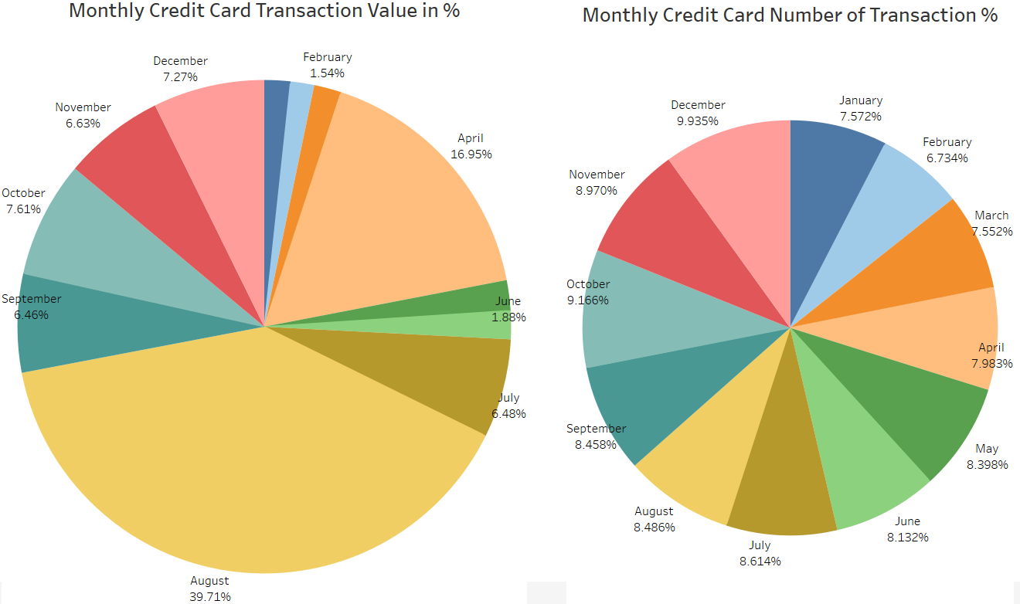
In this visualization, the left pie chart shows the transaction value on monthly basis for Credit Card
The right pie chart shows the number of transaction done on monthly basis for Credit Card.
Again we see top months are Apri(17%)l and August(40) in terms of transaction value.
However, compare to debit card it’s other way around, August is top and April is on 2nd spot.
The reasoning behind top spend in April and August seems to be same i.e. start of holiday , wedding season in April and Festival season for August.
For number of transactions trend show similar trend throughout the year, matching with Debit card trend.
The swipe data includes usage at ATM as well as PoS.
Dashboard Link
Note: hover over on the bubble to see the details.

